Slide 1
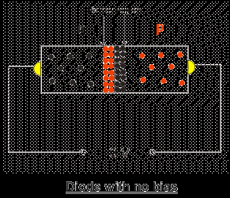
Saturation Current of PN junction

Slide 2
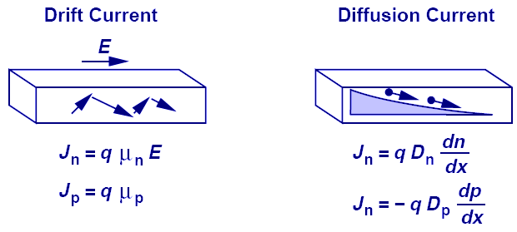
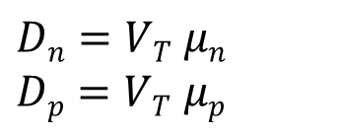
Einstein's Relation
Boltzman constant
Diffusion constant
Temperature
Magnitude of electron charge
Diffusion constant
$Dn=VT$ $μn$
$Dp=VT$ $μp$
Diffusion constant
While the underlying physics behind drift and diffusion currents are totally different, Einstein’s relation provides a mysterious link between the two.

Slide 3
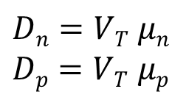
Saturation Current Calculation
Diffusion constants
$Dn=VT$ $μn$
$Dp=VT$ $μp$
PN junction current
Saturation current
V: Applied forward bias voltage
D_{p,n}: Diffusion constants
n_{i}: Free electrons in intrinsic semiconductor material
A: Cross sectional area of PN junction
L_{p}: Diffusion length of holes in the n material.
L_{n}: Diffusion length of electrons holes in the p material.
N_{A,D}: Number acceptor (donor) atoms

Slide 4
Diffusion length
Diffusion length is the average length a carrier moves between generation and recombination.
Semiconductor materials that are heavily doped have greater recombination rates and consequently, have shorter diffusion lengths.
L_{p}: Diffusion length of holes in the n material.
L_{n}: Diffusion length of electrons holes in the p material.

